Slide 1
Lab 4 Join
United International College

Slide 2
Motivation
Are you tired of condition checking in cross table queries?
The NATURAL JOIN operator associates two tables by the common attributes.
After NATURAL JOIN, the duplicated attributes are omitted.
For example,
SELECT * FROM city NATURAL JOIN country
is implemented as
SELECT city.country_id, city.last_update, city_id, city, country
FROM city, country
WHERE city.country_id = country.country_id AND
city.last_update = country.last_update

Slide 3
Example
Find the address for each customer, show the customer name, street, district, and postal code.

Slide 4
Join Condition
Why does the following query not work?
SELECT first_name, last_name, address, district, postal_code
FROM customer NATURAL JOIN address
It is equivalent to
SELECT first_name, last_name, address, district, postal_code
FROM customer, address
WHERE customer.address_id = address.address_id AND
customer.last_update = address.last_update
last_update is also checked because it is a common attribute.
If customers and addresses are not updated at the same time, last_update is not equal. Then, the predicate is always false.

Slide 5
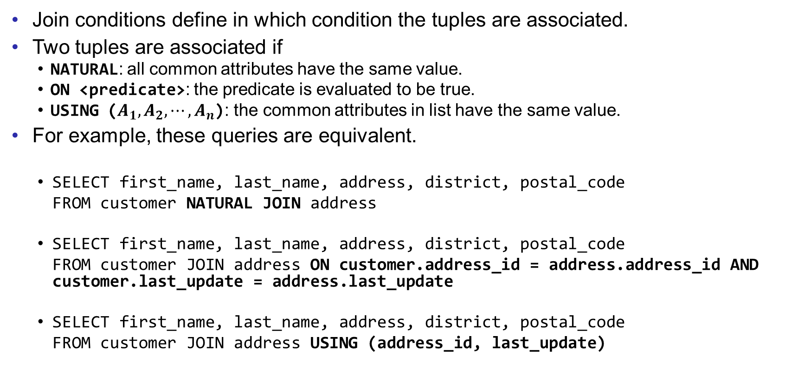
Join Condition
Join conditions define in which condition the tuples are associated.
Two tuples are associated if
NATURAL: all common attributes have the same value.
ON <predicate>: the predicate is evaluated to be true.
USING ($A_{1},A_{2},⋯,A_{n}$): the common attributes in list have the same value.
For example, these queries are equivalent.
SELECT first_name, last_name, address, district, postal_code
FROM customer NATURAL JOIN address
SELECT first_name, last_name, address, district, postal_code
FROM customer JOIN address ON customer.address_id = address.address_id AND customer.last_update = address.last_update
SELECT first_name, last_name, address, district, postal_code
FROM customer JOIN address USING (address_id, last_update)

Slide 6
Join Condition
A JOIN without any condition is same as a cartesian product.
Compare the outcome of these queries.
SELECT * FROM staff, store
SELECT * FROM staff JOIN store
Sometimes more than two tables are joined together.
SELECT * FROM table1 NATURAL JOIN table2 NATURAL JOIN table3
The query is understood as
SELECT * FROM (table1 NATURAL JOIN table2) NATURAL JOIN table3

Slide 7
Example
Fix the problem caused by the common attribute last_update on page 4.
Find the name of the manager of each store. You have to use JOIN.
Notes:
The predicate in the ON clause is user defined, which is very flexible.
NATURAL and USING combine the common attributes. But ON duplicates common attributes.

Slide 8
Join Type
Sometimes users want to keep the unmatched tuples after joining two tables.
OUTER JOIN can handle it.
table1 NATURAL LEFT OUTER JOIN table2
All tuples in table1 are in the result. For the unmatched tuples, the values of the attributes from table2 are NULL, meaning “unknown”. (NULL values will be introduced in following labs.)
table1 NATURAL RIGHT OUTER JOIN table2
The unmatched tuples from table2 are kept.
table1 NATURAL FULL OUTER JOIN table2
All tuples (from both table1 and table2) are kept.
NATURAL is the join condition.
On the opposite of OUTER, INNER JOIN does not keep the unmatched tuples.
Same as JOIN. “INNER” is usually omitted.

Slide 9
OUTER JOIN
Name | A_id
Alice | 1
Bob | 3
A_id | Address
1 | 2000 Jintong
2 | 300 Jinfeng
Suppose we try to join the two tables.
SELECT *
FROM person NATURAL LEFT OUTER JOIN address
SELECT *
FROM person NATURAL RIGHT OUTER JOIN address
SELECT *
FROM person NATURAL FULL OUTER JOIN address
Table: person
Table: address
Name | A_id | Address
Alice | 1 | 2000 Jintong
Bob | 3 | NULL
Name | A_id | Address
Alice | 1 | 2000 Jintong
NULL | 2 | 300 Jinfeng
Name | A_id | Address
Alice | 1 | 2000 Jintong
Bob | 3 | NULL
NULL | 2 | 300 Jinfeng

Slide 10
Example
For each of the address, find the customer who lives there. Display all addresses, even for the address that nobody lives.

Slide 11
Exercises
Write SQLs for the following questions. You have to use JOIN for each of the query.
Find the films (title) played by Zero Cage.
Find the films (title) rented by George Linton. The join condition is ON.
Find the customers (name) who have rented some action (category) films. The join condition is USING.
Join the tables film, film_category, and category, using both conditions ON and USING.
Find all pairs of customers (name) who have rented a same film. Any join condition is fine.
Find the films rented by each customer. If a customer has not rented any film, give it a NULL value.
Save your queries in a txt file. Rename it as “COMP3013 Lab4 ###.txt”, where “###” is your student ID. And submit it on iSpace. The DDL is 24 hours after the lab.

Slide 12
End of Lab 4

